Slide 1




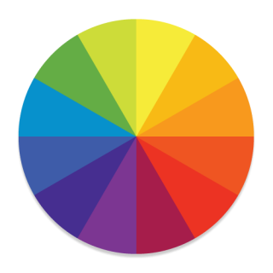

78 %
PlayStation 4 controller connected
Util category
Background monitoring
Live battery overlay
Customize Vibe
Others
Protect battery Limit charging to 80%

